Slide 1
personal income and expenditure IN New York
Gege Li
Xiaojia He

Slide 2
contents
1. Motivation
2. Income: Race and occupation difference,
Salary range percentage ,
County difference
3. Expenditure: Trend in recent years,
Expenditure proportion in three main variables
4. Conclusion
5. challenges we met

Slide 3
motivation
As the financial center of the world, the personal consumption and income in New York is higher than most cities.
We want to sum up some information on the living standard in New York.

Slide 4
income

Slide 5
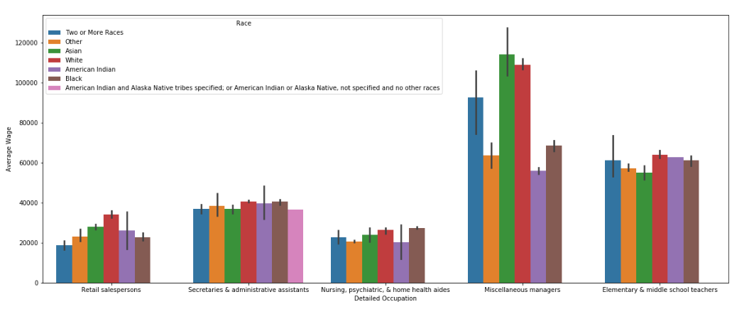
income difference: race and jobs

Slide 6
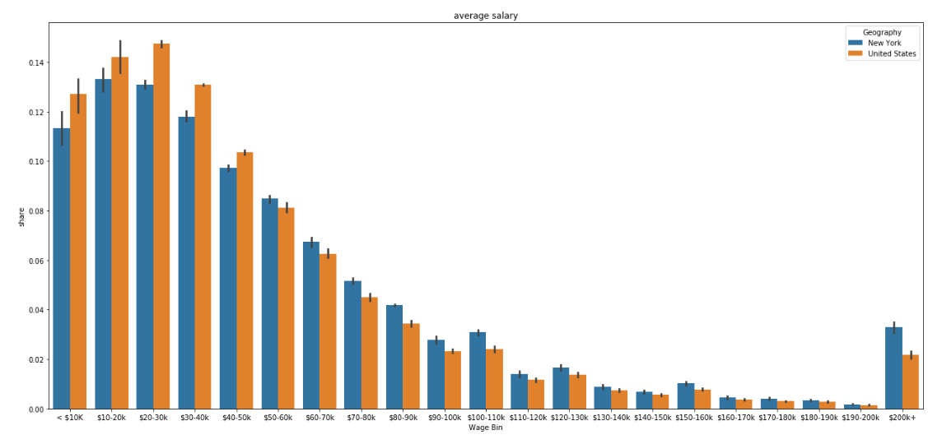
Income difference: Salary range

Slide 7
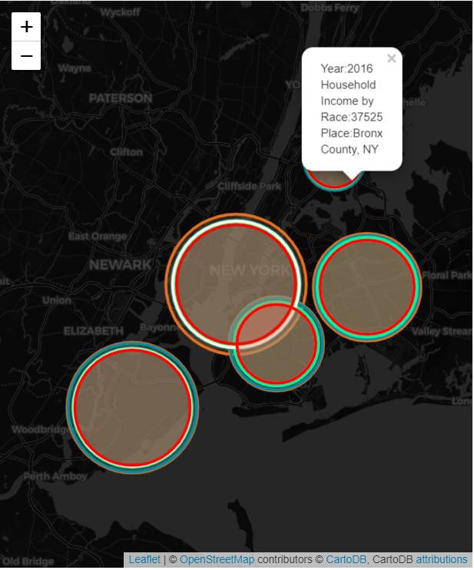
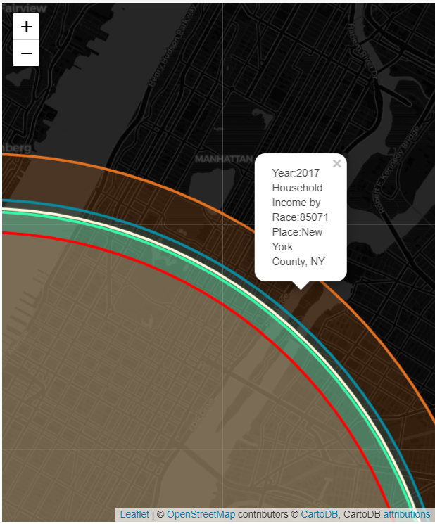
income difference:
county

Slide 8
expenditure

Slide 9
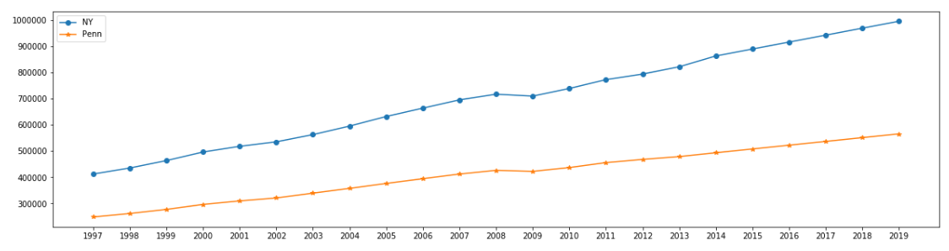
trend in recent years
Notes:
The last measured personal consumption expenditure for New York was $863,447 in 2014. New York experienced an average growth rate of 6.43% from our first statistic recorded in 1997. If past trends continue, we forecast the personal consumption expenditure to be $996,102 by 2019.

Slide 10
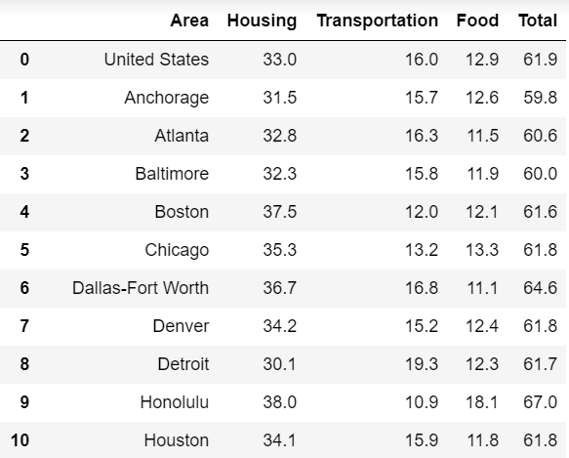
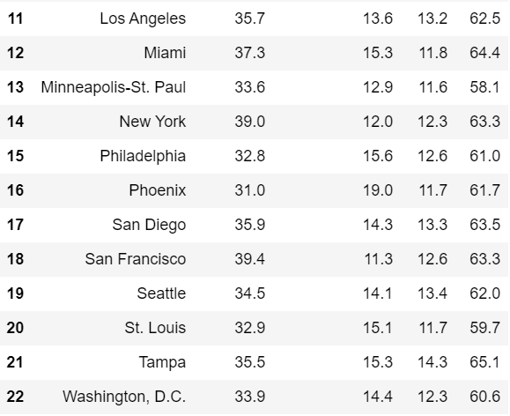
proportion of housing, transportation and food

Slide 11
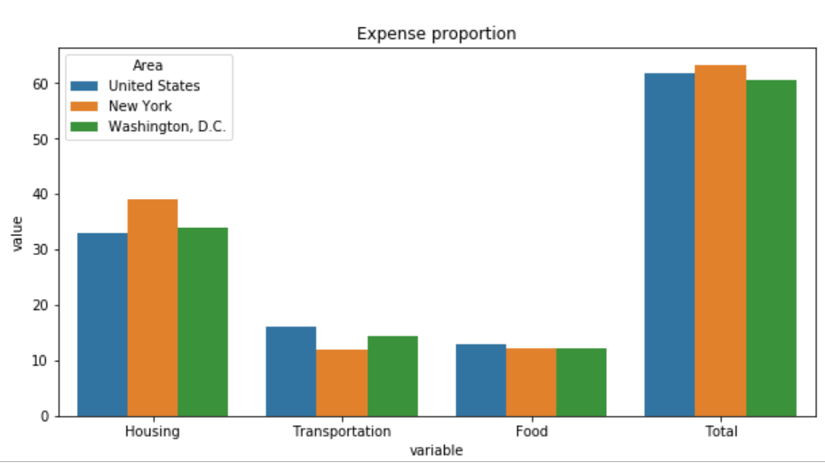
proportion and comparison

Slide 12
Challenges
Can not use the figsize to change the size of catplot
How to drew the geography to show to the income

Slide 13
Conclusions
The income increased every year, and the gap of income in different races is huge, especially between white and American India.
Among different jobs, wages are different. Miscellaneous managers earn more than 3 times than Nursing; But for Nursing and retail salespeople, they earn almost the same in New York.
The total proportion of Housing, transportation and food is more than half which means people can still save money.

Slide 14

THANK YOU

